Slide 1

TINY
TEMPO
A FETAL MONITORING MOBILE HEALTH APPLICATION
Sloan Atkins
Kate Brykalova
Ella Hartsell
1
Tiny Tempo

Slide 2
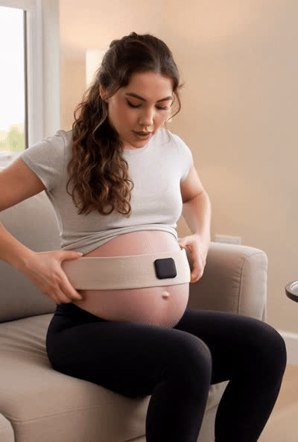
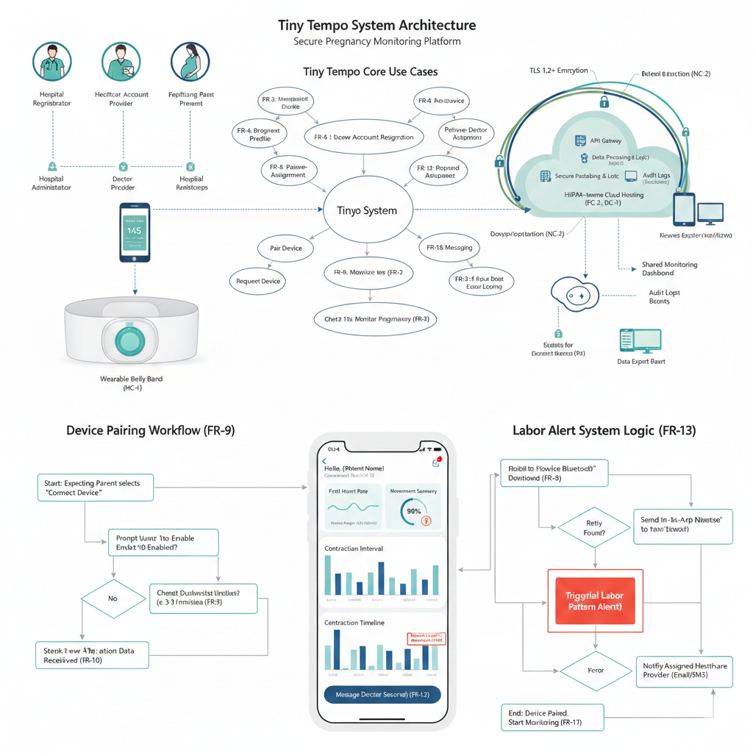
Photo and Video Generated by Gemini
INTRODUCTION
Tiny Tempo is a cloud-based maternal monitoring platform that integrates a wearable belly band device with a mobile application and provider dashboard. The system enables real-time fetal monitoring, secure data, and communication between expecting parents and healthcare providers.
Sloan Atkins
Kate Brykalova
Ella Hartsell
Tiny Tempo
2

Slide 3



AGENDA
INTRODUCTION
FUNCTIONAL REQUIREMENTS
NON-FUNCTIONAL REQUIREMENTS
SYSTEM CONSTRAINTS
EVOLUTIONARY REQUIREMENTS
USE CASES AND USE CASE DIAGRAM
SYSTEM MODEL
SYSTEM ARCHITECTURE DESIGN
DESIGN PATTERNS
MOCKUP INTERFACE
CONCLUSION / REFRENCES
Sloan Atkins
Kate Brykalova
Ella Hartsell
Tiny Tempo
3

Slide 4



THE TEAM
SLOAN ATKINS
KATE BRYKALOVA
ELLA HARTSELL
Junior, Majoring in Computer Science & Mathematics
Senior, Majoring in Computer Science
Junior, Majoring in Computer Science & Interactive Media
Sloan Atkins
Kate Brykalova
Ella Hartsell
Tiny Tempo
4

Slide 5
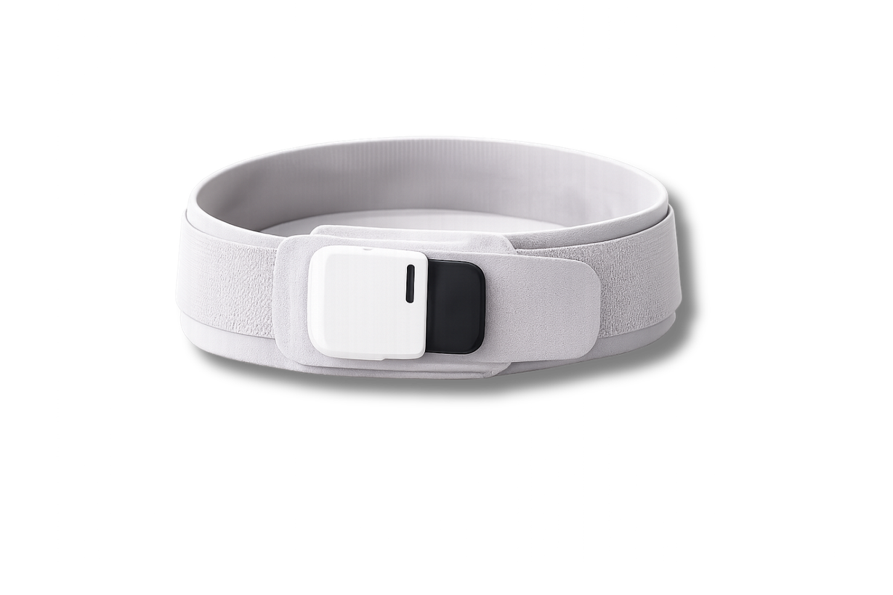
CONCEPT
CORE COMPONENTS
USER ROLES
Wearable Band
Stomach Monitor Device
Mobile Application
Patient interface
Provider Dashboard
Hospital Administrator
Healthcare Provider
Expecting Parents
Sloan Atkins
Kate Brykalova
Ella Hartsell
Tiny Tempo
5
Notes:
Components include the wearable that will collect the data.
The mobile application, which is the interface for the patients that enables device pairing, monitoring, and alerts
And the provider dashboard that allows doctors to review data, approve devices, and manage care
--------------------------------

Slide 6

FUNCTIONAL REQUIREMENTS
ACCOUNT & ACCESS MANAGEMENT
CARE COORDINATION & DEVICE WORKFLOW
MONITORING, ALERTS & DATA MANAGEMENT
FR-1, FR-2, FR-3, FR-4, FR-16
FR-5, FR-6, FR-7, FR-8, FR-9, FR-14
FR-10, FR-11, FR-12, FR-13, FR-15, FR-17
Sloan Atkins
Kate Brykalova
Ella Hartsell
Tiny Tempo
6

Slide 7

NON-FUNCTIONAL REQUIREMENTS
SECURITY & COMPLIANCE
PERFORMANCE & USABILITY
RELIABILITY & SCALABILITY
NFR-1, NFR-2, NFR-3, NFR-12
NFR-4, NFR-5, NFR-6, NFR-9, NFR-10
NFR-7, NFR-8, NFR-11
Sloan Atkins
Kate Brykalova
Ella Hartsell
Tiny Tempo
7

Slide 8

SYSTEM CONSTRAINTS
TOOLS
LANGUAGE
PLATFORM
HARDWARE
NETWORK
TC -1
Version Control
LC -1
Backend Language
PC -1
Mobile Platform Support
HC -1
Wearable Belly Band
NC -1
Internet Connectivity
TC - 2
UI Design & Prototyping
LC - 2
Frontend Language
PC - 2
Cloud Hosting Platform
HC - 2
Bluetooth Capability
NC - 2
Encrypted Transmission
TC - 3
CI/CD
NC - 3
Offline Data Buffering
PC - 3
Database Platform
HC - 3
Development & Testing
TC - 4
Team Communication
NC - 4
API Hosting
Sloan Atkins
Kate Brykalova
Ella Hartsell
Tiny Tempo
8

Slide 9
EVOLUTIONARY REQUIREMENTS
1
2
3
BILINGUAL SUPPORT
VIDEO CONSULTATION
KICK COUNT TRACKING
The system shall support English and Spanish throughout the app.
The system shall allow doctors and patients to conduct video calls within the app.
The system shall allow parents to manually log fetal kick counts.
Sloan Atkins
Kate Brykalova
Ella Hartsell
Tiny Tempo
9

Slide 10
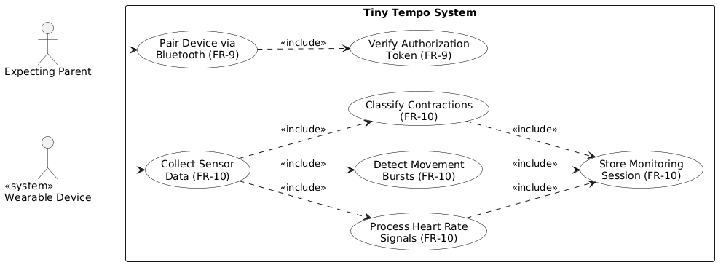
UC-5: DEVICE PAIRING + MONITORING
FR-10: Monitoring & Data Classification
The system shall collect, process, classify, and store fetal heart rate, movement, and contraction data.
Sloan Atkins
Kate Brykalova
Ella Hartsell
Tiny Tempo
10

Slide 11
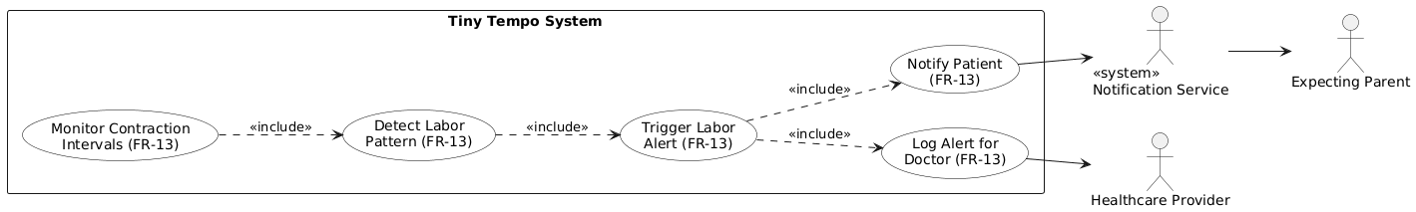
UC-7: LABOR ALERTS + NOTIFICATIONS
FR-13: Labor Pattern Alert
The system shall notify patients when contraction intervals fall below predefined thresholds for a sustained duration.
Sloan Atkins
Kate Brykalova
Ella Hartsell
Tiny Tempo
11

Slide 12
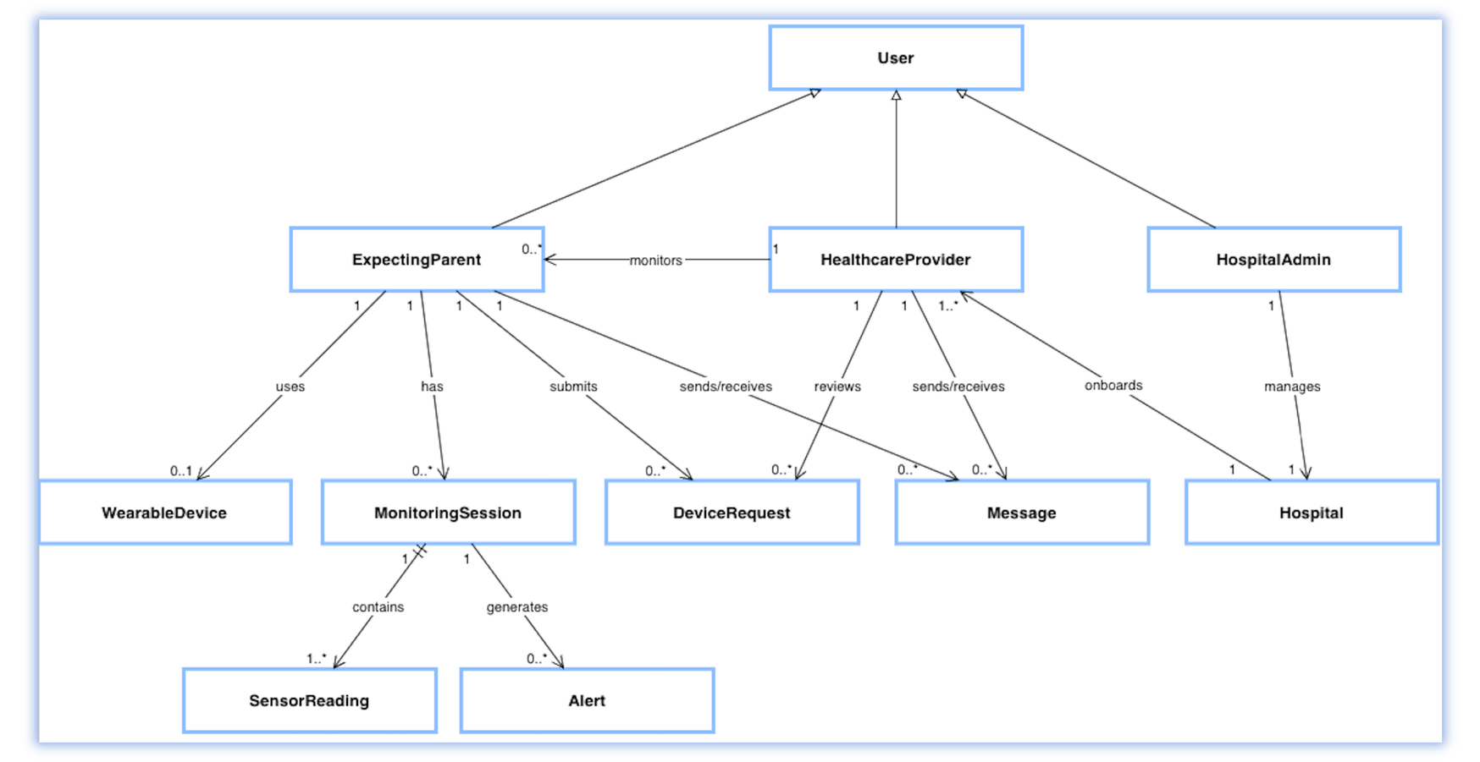
SYSTEM MODEL
CLASS ASSOCIATION DIAGRAM
Sloan Atkins
Kate Brykalova
Ella Hartsell
12
Tiny Tempo

Slide 13
SYSTEM MODEL
DETAILED CLASS DIAGRAMS
CD-1: User
- userID: String - name: String - email: String - passwordHash: String - role: UserRole
+ register() + login() + verify()
CD-8: MonitoringSession
- sessionID: String - startTime: DateTime - endTime: DateTime - status: SessionStatus
+ startSession() + endSession() + uploadBufferedData()
List of Class Diagrams
CD-1: User
CD-2: ExpectingParent
CD-3: HealthcareProvider
CD-4: HospitalAdmin
CD-5: Hospital
CD-6: WearableDevice
CD-7: DeviceRequest
CD-8: MonitoringSession
CD-9: SensorReading
CD-10: Alert
CD-11: Message
Sloan Atkins
Kate Brykalova
Ella Hartsell
13
Tiny Tempo

Slide 14
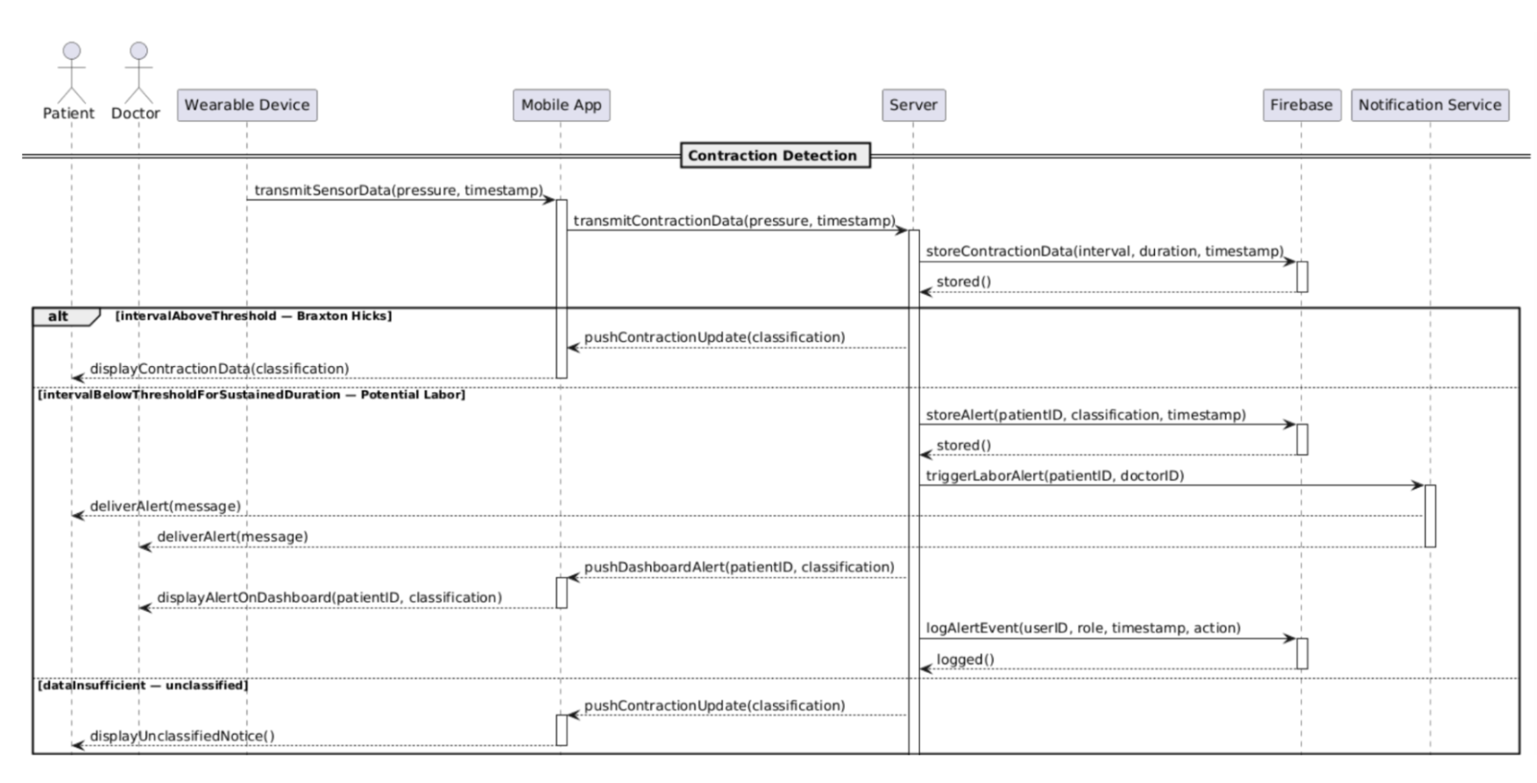
SYSTEM MODEL
SEQUENCE DIAGRAM
Sloan Atkins
Kate Brykalova
Ella Hartsell
Tiny Tempo
14

Slide 15
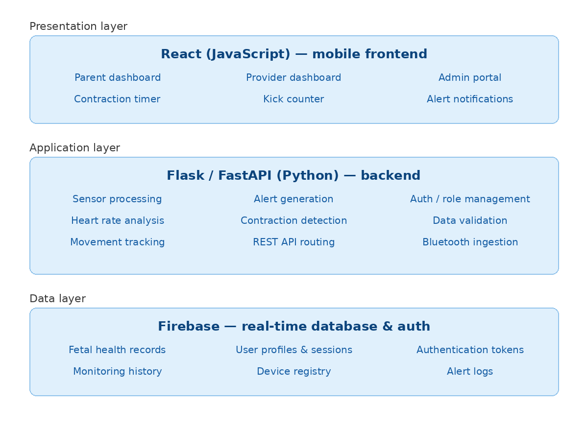
SYSTEM ARCHITECTURE DESIGN
THREE-TIER LAYERED ARCHITECTURE
Sloan Atkins
Kate Brykalova
Ella Hartsell
Tiny Tempo
15

Slide 16
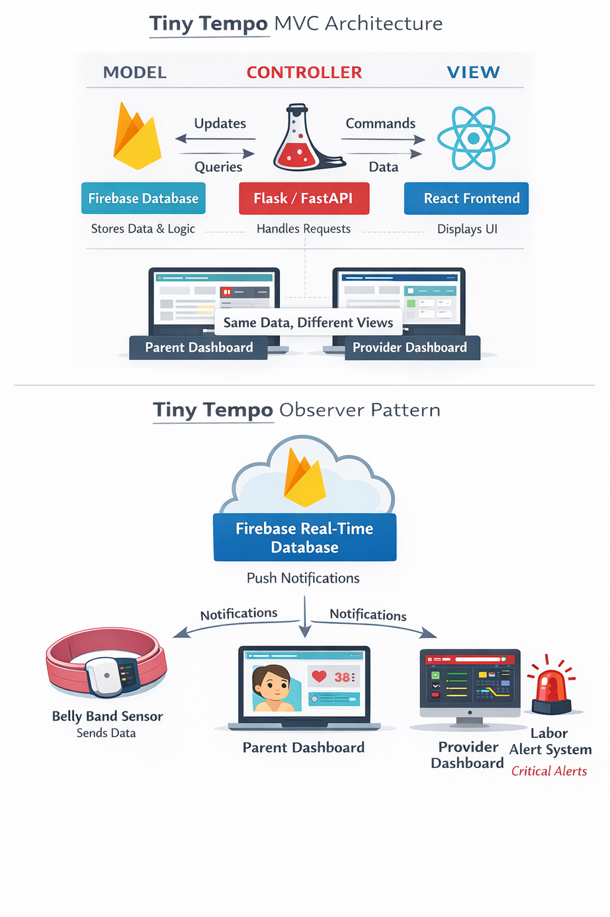
DESIGN PATTERN
OBSERVER PATTERN
Sensor data (belly band) acts as the Subject
Parent dashboard, provider dashboard, and labor alert system act as Observers
When the backend writes new sensor data, all three Observers are notified and updated automatically, no manual polling required
Sloan Atkins
Kate Brykalova
Ella Hartsell
Tiny Tempo
16
Notes:
Components include the wearable that will collect the data.
The mobile application, which is the interface for the patients that enables device pairing, monitoring, and alerts
And the provider dashboard that allows doctors to review data, approve devices, and manage care
--------------------------------

Slide 17
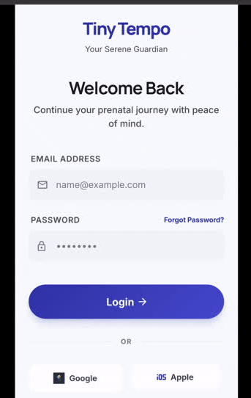
MOCKUP INTERFACE
User account registration and login
Pregnancy profile setup
Real-time monitoring dashboard
Labor alert notification
Patient–provider messaging
Sloan Atkins
Kate Brykalova
Ella Hartsell
Tiny Tempo
17

Slide 18

CONCLUSION
SYSTEM SUMMARY
Secure, cloud-based maternal monitoring platform
Integrated wearable device, mobile application, and provider dashboard
HIPAA-aware architecture with encrypted data handling
Real-time monitoring, alerts, and care coordination
Designed for scalability and future clinical expansion
Sloan Atkins
Kate Brykalova
Ella Hartsell
Tiny Tempo
18

Slide 19
RESOURCES & REFERENCES
Research Articles
Walter, J. R. (2022). The future of remote monitoring for pregnancy. National Center for Biotechnology Information. Retrieved from https://pmc.ncbi.nlm.nih.gov/articles/PMC10727511/
Stricker, K., & Gomez, L. (2024). Continuous remote home monitoring for pregnant women and unborn children. Computer Methods and Programs in Biomedicine, 244. Retrieved from https://www.sciencedirect.com/science/article/pii/S0301211524006924
Industry & Market
Bloomlife. (2025). Remote monitoring solutions for prenatal care. Retrieved from https://www.bloom-life.com/
Future Market Insights. (2025). Wearable pregnancy devices market outlook. Retrieved from https://www.futuremarketinsights.com/reports/wearable-pregnancy-devices-market
Popular Media
Time. (2024). How remote pregnancy monitoring is transforming care. Retrieved from https://time.com/7094692/nuvo-invu/
ET Edge Insights. (2025). How telemedicine and wearable health trackers are transforming prenatal care. Retrieved from https://etedge-insights.com/industry/healthcare/how-telemedicine-wearable-health-trackers-and-pregnancy-apps-are-transforming-prenatal-care/
Sloan Atkins
Kate Brykalova
Ella Hartsell
Tiny Tempo
19

Slide 20
QUESTIONS?
Sloan Atkins
Kate Brykalova
Ella Hartsell
Tiny Tempo
20

